Slide 1
AYUSH Startup Registration Portal
CSE7101- Capstone Project
Review-1
Batch Number: 3
Under the Supervision of,
Dr.Saravana Kumar S
Associate Professor
School of Information Science
Presidency University
Roll Number | Student Name
20221CSD0110 | GANGADHARA
20221CSD0109 | CHANDAN KUMAR
20221CSD0154 | NAVYASHREE E
Name of the Program: B.Tech
Name of the HoD: Dr. Pravinthraja S
Name of the Program Project Coordinator: Dr. H M Manjula
Name of the School Project Coordinators: Dr. Sampath A K , Dr. Geetha A

Slide 2
Problem Statement Number: PSCS_285
Organization: Ministry of AYUSH
Category (Hardware / Software / Both) : Software
Problem Description:
The AYUSH sector is growing rapidly with innovative startups, but the current registration process is manual, slow, and lacks transparency. Startups face delays in compliance, difficulty tracking applications, and challenges with document verification. A centralized online portal is needed to provide secure authentication, easy application submission, document uploads, and real-time status tracking, ensuring efficiency, transparency, and better integration of AYUSH startups into the healthcare ecosystem.

Slide 3
Content
Problem Statement
Objectives
Background and Related work for title Selection
Analysis of Problem Statement
Innovation or Novel Contributions
Git-hub Link
Timeline of the Project
References

Slide 4
Problem Statement
Current startup registration process in AYUSH sector is time-consuming, manual, and lacks transparency.
Startups face challenges in tracking applications, uploading compliance documents, and receiving timely updates.
Absence of a centralized portal reduces accessibility and efficiency.
Need for a digital, secure, and transparent registration system that integrates stakeholders.

Slide 5
Objectives
To design and develop a comprehensive online registration portal for AYUSH startups.
To enable secure authentication for users, startups, and officials.
To provide a document upload and compliance verification system.
To allow startups to track application status in real-time.
To create an admin panel for officials to review and approve/reject applications.
To ensure scalability, transparency, and user-friendliness.

Slide 6
Background & Related Work
Many sectors (MSME, Startup India portal) already use digital platforms for registration.
However, the AYUSH sector lacks a dedicated registration system tailored to its needs.
Existing solutions are fragmented and not user-friendly.
Related works show that digital workflows reduce processing time by 40–50%.
Our portal will be sector-specific, addressing AYUSH guidelines and compliance needs.

Slide 7
Analysis of Problem Statement
Analysis of Problem Statement
Users: Startups, Officials, Admins
Key Features Needed:
User Authentication (Startups & Officials)
Application Submission with document uploads
Real-time tracking and notifications
Role-based access control
Data security and compliance with AYUSH norms
Challenges: Handling sensitive data, ensuring scalability, and seamless UI/UX.

Slide 8
Technology Stack
Frontend: React.js
Backend: Node.js with Express
Database: MongoDB
Authentication: JWT / OAuth2.0
Cloud Deployment: Vercel
Document Storage: AWS S3 / Firebase Storage
Version Control: GitHub

Slide 9
Innovation / Novel Contributions
A dedicated, sector-specific registration system for AYUSH startups.
Real-time status tracking and notification system.
Secure document upload and verification.
Admin dashboard for official reviews & analytics.
Scalability for future AYUSH integrations (funding schemes, compliance tracking).

Slide 10
GitHub Link
GitHub Repository : https://github.com/Gangadhara2829/Ayush-Startup-Registration-Portal

Slide 11
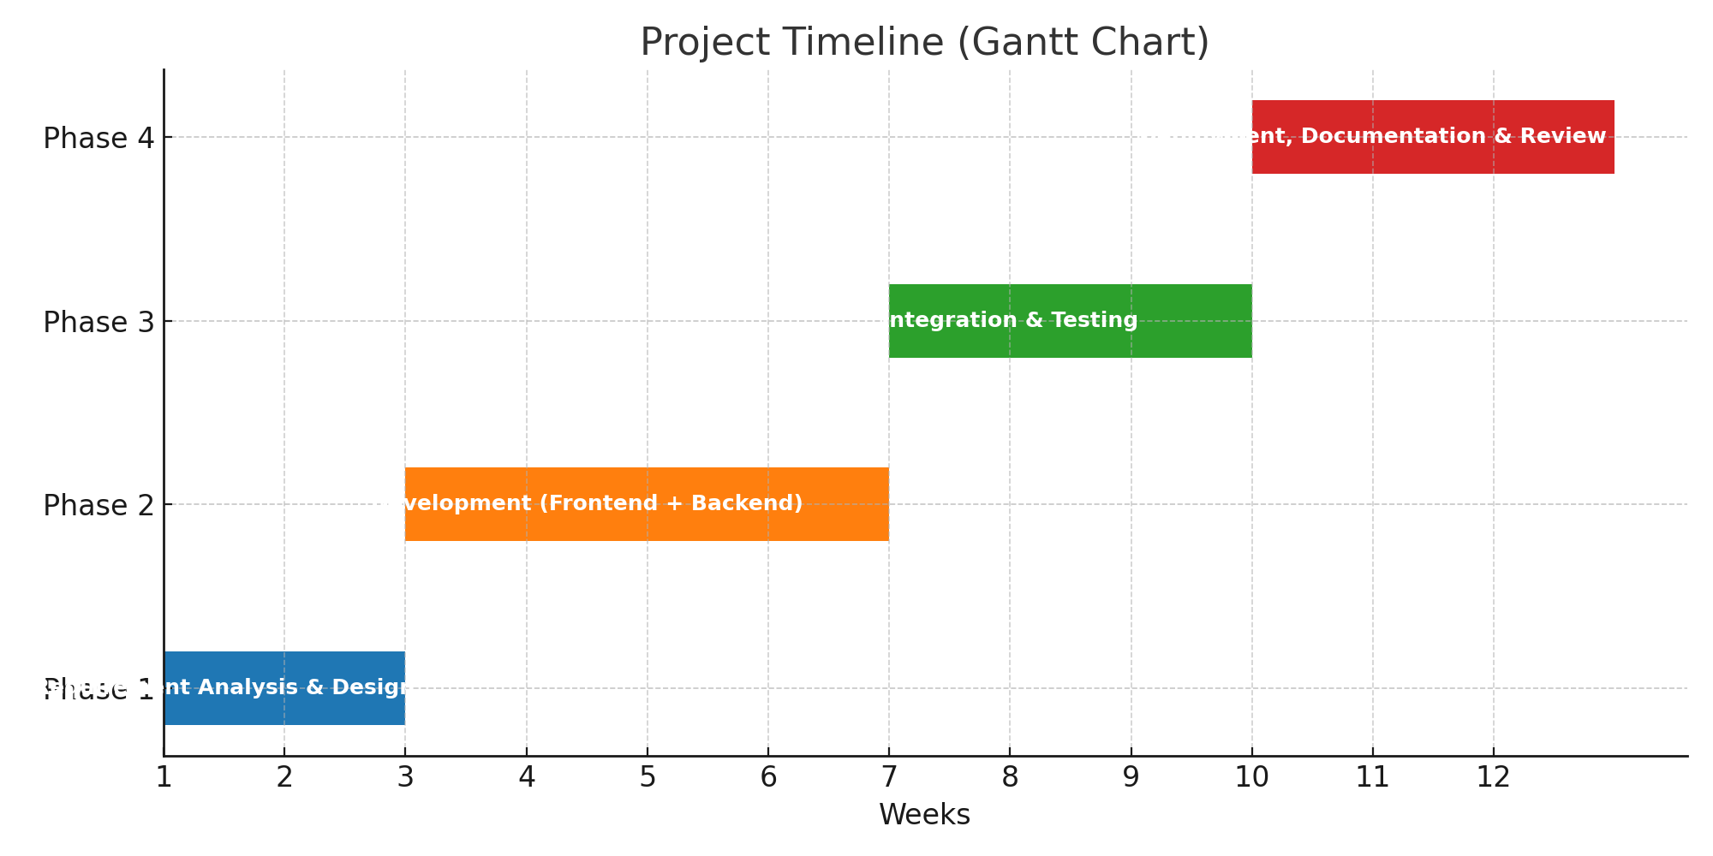
Timeline (Gantt Chart)
Week 1–2: Requirement Analysis & Design (SRS, ER Diagram, Wireframes)
Week 3–6: Development (Frontend + Backend)
Week 7–9: Integration & Testing (APIs, DB, Role-based access)
Week 10–12: Deployment, Documentation, and Final Review

Slide 12
References (IEEE Paper format)
Ministry of AYUSH, “Startup India: Promoting Innovation in AYUSH Sector,” Govt. of India, 2023.
A. Kumar, B. R. Patel, and C. Zhang, “E-Governance platforms for startup ecosystems,” IEEE Access, vol. 9, pp. 34567–34578, Mar. 2021.
J. Smith, “Secure Web Portals for Digital Registrations,” IEEE Transactions on Information Systems, vol. 32, no. 7, pp. 1234–1245, Jul. 2021.

Slide 13


